Slide 1

Interact
By: Jeffin Alex George
R. sreehari
shilpa s. j. nair
sruthi Mariam thomas

Slide 2
OBJECTIVE
Our project aims to change any existing projector system gesture enabled by attaching a detection and processing unit to it. This will enable users to interact with computers using gestures(touch/finger tracking)on projected screens.

Slide 3
MOTIVATION
Making projected screens gesture enabled will eliminate the difficulty faced while using conventional input devices.

Slide 4
NOVELTY
A universal snap-on is provided which can be added, making the projected screens gesture enabled. Other existing technologies cannot be used as an add-on.

Slide 5
Ref 1: Making any planar surface into a touch-sensitive display by a mere projector and camera By Jingwen Dai and Ronald Chung
LITERATURE SURVEY
A random binary pattern is employed to code structured light, which is embedded into the regular projection display.
The observed image data, plus the known projection content, can work together to decide if there is a finger present and if the finger touches the table surface, and if so at what position of the table surface the finger tip makes the contact.
REF 2: Real time hand tracking and 3D gesture recognition for interactive interfaces using HMM By C. Keskin, A. Erkan, L. Akarun
A gestural interface based on real-time hand tracking and 3D gesture recognition.
The proposed system uses two color cameras for 3D reconstruction, 2D and 3D Kalman filters for noise elimination, and HMM for gesture recognition.

Slide 6
REF 3: Self-adaptive coding-based touch detection for interactive projector system By Ming He and Jun Cheng
Simple approach to extract hand region and detect fingertips, removing the influence of hand shadow.
Used for touch detection without complex 3D reconstruction to compute the depth information of the fingertips.
Precise performance of hand region extraction and touch detection under different conditions, including static and dynamic backgrounds, bright and dark environment light.
REF 4: A new method of detecting fingertip touch for the projector-camera HCI system By Xilei Cai , Xiang Xie , Guolin Li , Wei Song , Yi Zheng ,Zhihua Wang
A finger model composed of a quarter-sphere and half a cylinder is introduced and the geometry of fingertip point and its shadow point is presented.
Measures the distance between the finger and the projected surface.

Slide 7
REF 5: Interactive touch board using IR camera By Ramsundar K G
Interacts with the project display using IR camera and IR stylus.
The stylus has an infrared LED at its tip and is capable of producing a tiny spot of light on the projected surface, which is invisible to human eyes.
An IR camera with IR pass filter is used to capture the light spot and is processed further.

Slide 8
BLOCK DIAGRAM

Slide 9
HARDWARE & SOFTWARE REQUIRED
Kinect
Wireless camera
Raspberry Pi
OpenCV

Slide 10
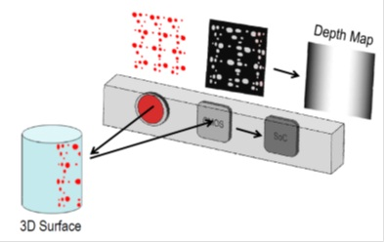
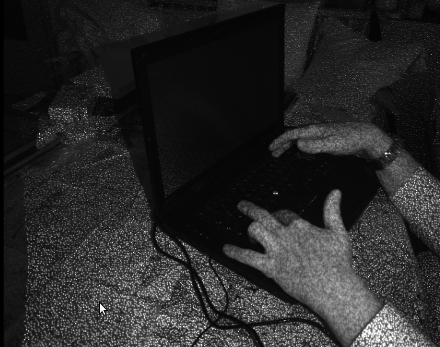
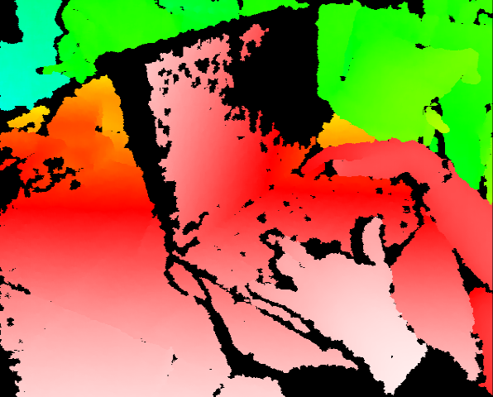
KINECT
Kinect is a line of motion sensing input devices by Microsoft for Xbox 360 and Xbox One video game consoles and Windows PCs.
It projects an IR pattern on to a surface and the pattern is read by a camera and the depth can be obtained.
Infrared image showing depth measurement .
The depth map visualized using color gradients from white (near) to blue (far).
Essential KINECT Working

Slide 11
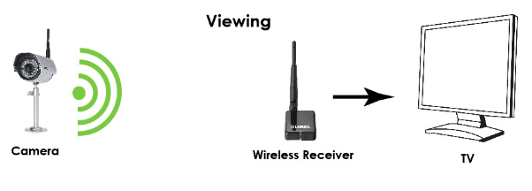
WIRELESS CAMERA
The camera contains a wireless transmitter. This transmitter broadcasts the camera's video, which can be picked up by a receiver, which will be connected to a monitor.

Slide 12
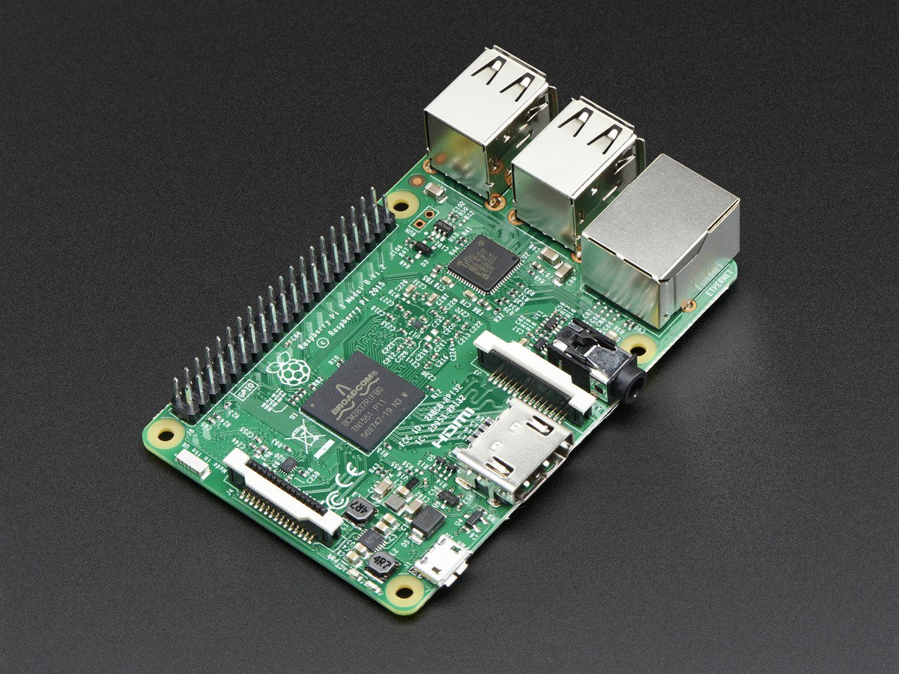

RASPBERRY PI
The Raspberry Pi is a single-board, low-cost, high-performance computer.
It is a credit card-sized computer that plugs into TV and keyboard. It is a capable little computer which can be used for many of the things that the desktop PC does.

Slide 13

OPENCV
OpenCV (Open Source Computer Vision) is a library of programming functions mainly aimed at real-time computer vision.
It is an open source computer vision and machine learning software library.

Slide 14
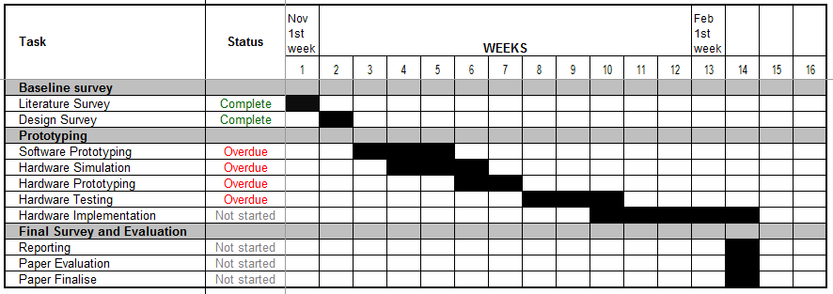
WORK PLAN

Slide 15
REFERENCES
J. Dai and R. Chung, "Making any planar surface into a touch-sensitive display by a mere projector and camera," in Computer Vision and Pattern Recognition Workshops (CVPRW), 2012 IEEE Computer Society Conference on, 2012, pp. 35-42.
Ming He and Jun Cheng, “Self-Adaptive Coding-based Touch Detection for Interactive Projector System”, in 4th IEEE International Conference on information Science and Technology (ICIST),2014.
Ramsundar K G, “Interactive Touch Board using IR Camera”, in IEEE Sponsored 2nd International Conference On Electronics And Communication System (ICECS 2015).
Xilei Cai, Xiang Xie, Guolin Li, Wei Song, Yi Zheng, and Zhihua Wang, “ A New Method Of Detecting Fingertip Touch For The Projector-Camera HCI System”, in IEEE International Symposium on Circuits and Systems (ISCAS),2014.
C. Keskin, A. Erkan, and L. Akarun, ” Real time hand tracking and 3D Gesture Recognition for Interactive interfaces using HMM”, in IEEE International Conference on Robotics and Biometrics (ROBIO),2015.

